Slide 1

SMART ASSISTANCE
PROJECT BY:
Aakansha Talati (010747360) Paxshal Mehta (010090197)
Kathan Sheth (010694944) Sanket Dhami (010652733)

Slide 2
Overview
The Internet of Things (IoT) will undoubtedly continue to make headlines in near future, with the issue of security becoming more and more prevalent.
The system include controlling any electrical appliance remotely along with monitoring place through video surveillance

Slide 3
Services
Control
Video
Status(Acknowledgement)

Slide 4
Control
Raspberry Pi plays the role of server in our application
Clients interact with server via GUI.
Electrical appliances are connected to GPIO pins of Raspberry PI
When Clients request for Turning On/off the devices, the server will serve concurrently

Slide 5
Video
In addition, when client requests for video, server captures the live video of the place and sends it to the client using TCP protocol.
When the client finds something wrong in the video it can send the request to turn on the BUZZER as an alert.

Slide 6
Acknowledgement
On asking for status of devices it will give the current state of devices(ON/OFF)

Slide 7
Purpose
Remote Access to the devices
in hurry
Emergency
Motor (water Pump)
Video Monitoring
child alone at home
Hospital (Patient Surveillance)
Robbery, Burglary
Acknowledgement
energy conservation

Slide 8
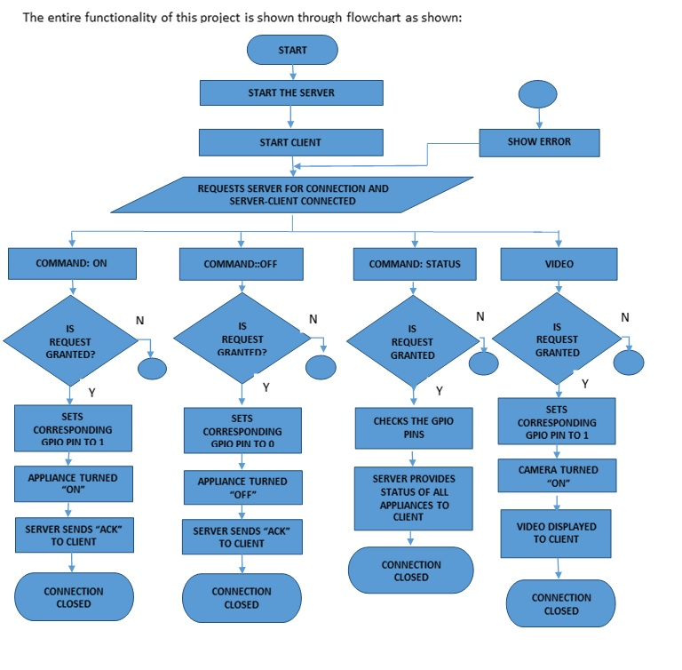

Slide 9
Hardware Used
Raspberry PI
Relay Board
Motor
Camera Module
LED

Slide 10
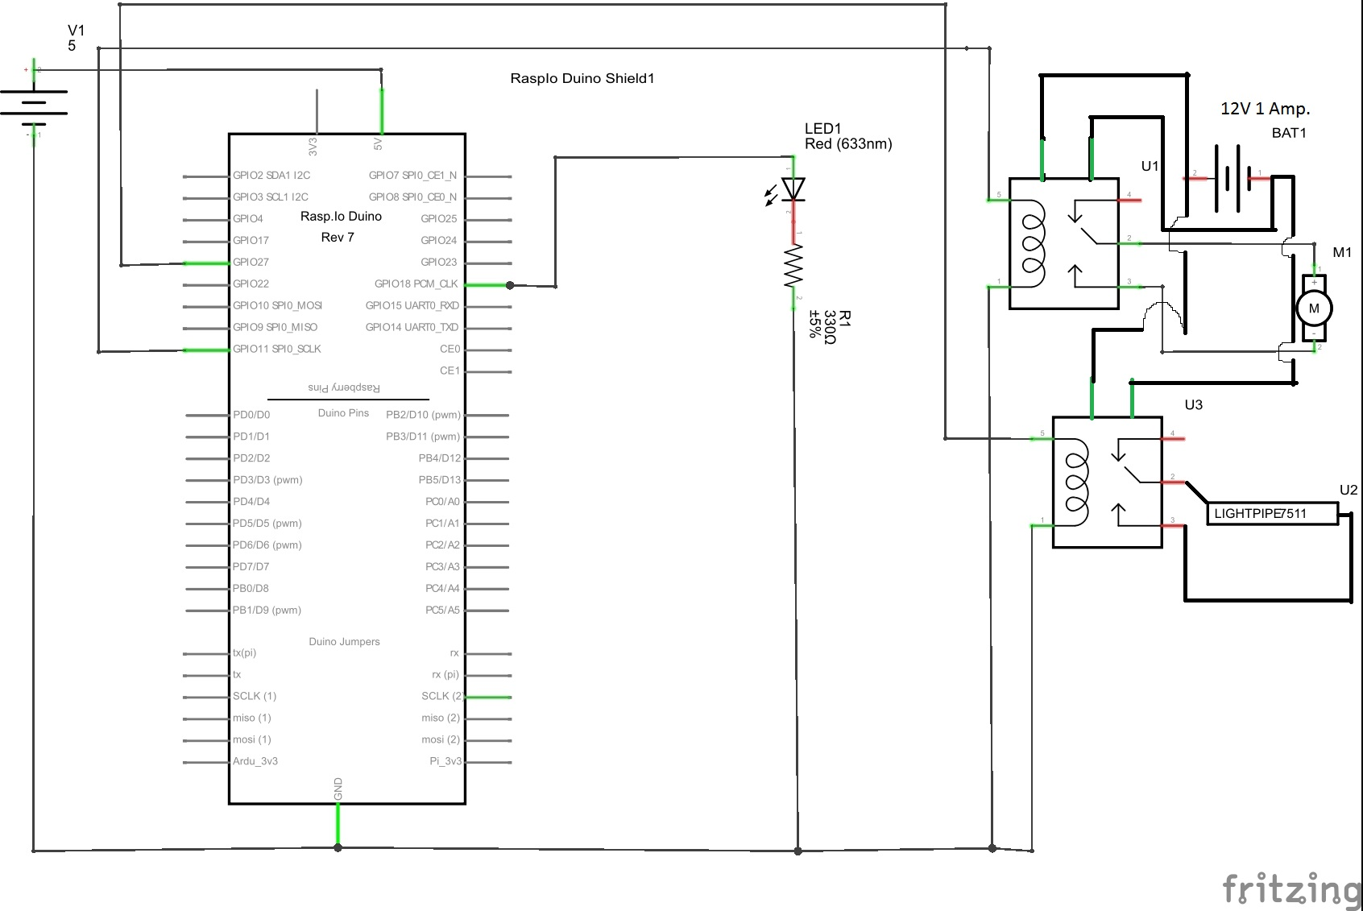

Slide 11
Setup of Server & Clients
Server with Raspbian OS
Clients operating on same network of Raspberry Pi(Server)
Clients operating on another network(Port forwarding)
Port Forwarding- Application which redirects a communication request from one address and port combination to another

Slide 12
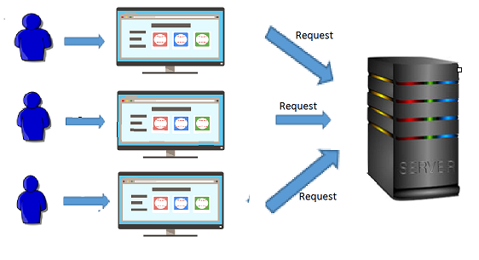
Client

Slide 13
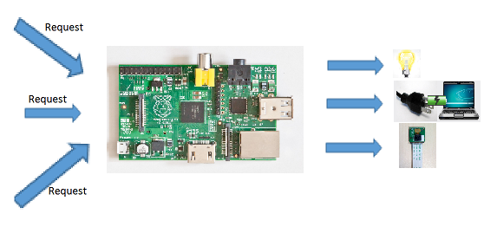
Server

Slide 14
Concurrent Server
For every connection, a thread is created.
(Master-Slave Socket concept)
Each client is able to turn on/off the appliances.
Each client can see the updated status of appliances anytime.

Slide 15
Protocol
TCP/IP
Most reliable source for transmission
No redundant packets
Why ?
Packet loss at crucial stage

Slide 16
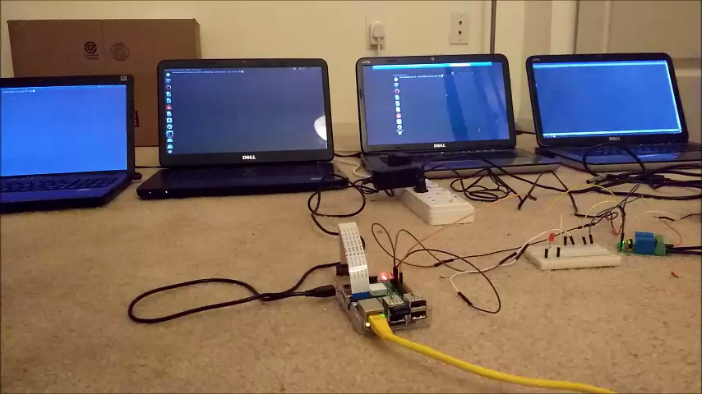
Demo

Slide 17
Scalability
Entirely IOT based application using add on sensors and real time cloud data
Organizations, Buildings, Traffic Lights and Street Video Surveillance and more
Website or Mobile app (more convincing)

Slide 18
THANK YOU

